Slide 1
Focused Note Taking
More is not better…
Better is better

Slide 2
Why take notes?
Partner discussion:
Why do we have students take notes?

Slide 3
Why take notes?
Just a study tool that we hope works?
Or, can note taking be an effective method for long-term memory retention and an catalyst for increased learning and achievement?

Slide 4
Some Questions to Think About…
Do students know HOW to take effective notes?
Do students know how to USE notes?
How can notes be most effectively used to retain relevant information?
Do I know that?
Do my students know that?
What does the research say about effective uses of note taking?

Slide 5
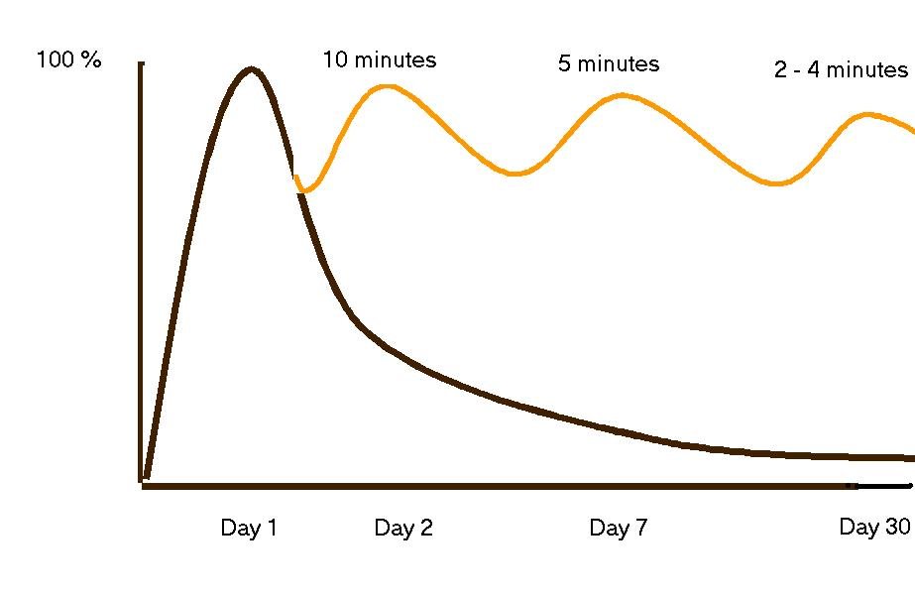
The Curve of Forgetting
The Curve of Forgetting describes how we retain or get rid of information that we take in. It's based on a one-hour lecture.
Notes without review: 97% information loss after 30 days
Notes with daily review: >80% information in long-term memory

Slide 6
As teachers, we cannot assume that our students are effective note takers and know how to effectively use their notes for learning. Effective note taking needs to be explicitly taught and practiced with students.

Slide 7
More importantly, because of a block schedule, effective note taking, note interacting and note review becomes all the more important because of the greater amount of time between class sessions.

Slide 8
Four Areas of Effective Note Taking
Note Taking
Note Making
Note Interacting
Note Reflecting

Slide 9
Four Areas of Effective Note Taking
Note Taking
Note Making
Note Interacting
Note Reflecting
Increased Student Learning and Achievement

Slide 10
The Cornell Way
Ten Steps in the Cornell Note Taking System

Slide 11
Cornell Notes
The Essential Question…
Heading
Student created, higher level questions
Notes Section
Notes Summary

Slide 12
Part I: Note-Taking
Step One: Create Format
Leave 1/3 of the paper on the left for questions, 2/3 on the right for notes
Leave 2 inches on the bottom of each page for summary
Create an essential question based on the learning target to be addressed in the notes and in the summary

Slide 13
Part I: Note-Taking
Step Two: Organize Notes on the Right Side of Your Note Paper
Take notes while listening to a lecture, reading a textbook, solving a math problem, etc.
Listen and take notes in your own words – paraphrase what you hear
Write in phrases, not complete sentences
Know what to write – differentiate between important information vs. trivial information

Slide 14
Part II: Note-Making
Step 3: Review and Revise Notes
Distinguish main ideas from details
Categorize information by highlighting or color coding
Delete unimportant information
Add your own thinking – fill in details to clarify, complete, or create greater meaning and understanding
Identify unclear information by using a question mark
Add references from other materials as they come to mind or make connections to other concept/content
Review for possible paper topics or test questions

Slide 15
Part II: Note-Making
Step 4: Note Key Ideas to Create Questions
Write questions on the left side of your notes page that connect to key ideas
Review the main ideas highlighter on the right side

Slide 16
Part II: Note-Making
Step 5: Exchange Ideas by Collaborating
Collaborate with a peer(s), as a small group, as a whole class, outside of class, etc. to compare, enhance, and revise your notes
Fill in any gaps and clarify points of confusion
Brainstorm a list of key terminology from the lesson to be included in the summary

Slide 17
Part III: Note-Interacting
Step 6: Link Learning to Create a Summary
Identify the main ideas to be used in the summary by reviewing your notes, questions written on the left side, and prior knowledge
Address the essential question of the lesson in the summary
Use the notes on the right side for support as you write the summary
Combine main ideas by synthesizing; internalize learning from the questions/notes
Answer the higher level questions on the left side in the summary to tie together the main ideas

Slide 18
Part III: Note-Interacting
Step 7: Learning Tool – Use Completed Notes as a Learning Tool
Review notes taken, questions developed, and the summary, individually or with a study group
Apply new learning to increase performance in the class by using notes to study for a test, write an essay, prepare for a presentation, etc.
Interact with material by taking notes, writing questions, and summarizing to internalize the information and increase subsequent learning
Use the notes to transfer knowledge to long-term memory by forming connections with and making meaning of the notes

Slide 19
Part IV: Note-Reflecting
Step 8: Written Feedback
Review, revise, and improve notes, questions, and summary based on feedback by a peer or instructor
Use the feedback to check for quality

Slide 20
Part IV: Note-Reflecting
Step 9: Address Written Feedback
Create a goal for improving future note-taking
Use the feedback provided to identify an aspect of note taking that challenges you
Identify specific actions to address this challenge in future note taking

Slide 21
Part IV: Note-Reflecting
Step 10: Your Reflection
Review your notes, questions and summaries, then reflect on your learning by completing a reflective log to show how you mastered and/or applied your new knowledge

Slide 22
Using 90 Minutes Effectively
10-2-2 Note Taking Structure

Slide 23
10-2-2 Structure & Rationale:
The structure involves the following:
10 minutes: presenting information/note-taking
2 minutes: Processing information
2 minutes: Summarizing information
Allows students the necessary time to process information and concepts presented in whole group instruction
The structure allows for:
Greater retention of information
Improvement in the quality of notes, question, and summaries

Slide 24
10 Minutes: Whole Group Instruction
The instructor lectures/presents information or gives and audio-visual presentation for ten minutes while the students take Cornell notes.
Encourage students to use abbreviations and short-cuts while taking notes.

Slide 25
2 Minutes: Partners/Small Groups
The instructor then pauses for two minutes while the students take time to process the information by working collaboratively in partners/small groups to do the following:
Sharing notes
Revising/refining notes
Filling in gaps in notes
Clarify information/concepts presented
Create questions on the left side
During this time students are not allowed to ask the instructor questions; students should rely on the support of peers to assist them in processing the information.

Slide 26
2 Minutes: Independently
The students then take two minutes silently to individually process the information and create a one-sentence summary to be placed across the page just below the chunk of notes.
The teacher may choose to have students share out their sentence summary as a way to check for understanding.

Slide 27
Repeat the Process
Repeat the process until all information is presented.

Slide 28
Last 5 Minutes: Whole Group
Reserve the last five minutes of the lesson for the students to interact with the teacher.
Students can ask questions to:
Resolved unanswered questions
Get clarification about information presented
Sort out misconceptions/gaps

Slide 29
Effective Note Taking as a Strategy in a 90 Minute Block...
Review of previous information is critical
Many of the steps in the Cornell Way would be excellent class activities
Breakup the note taking process
Give students opportunity to process the information in an effective way
Don’t blab on and on; give students a chance to learn
Teaching Content vs. Facilitating Learning
Students needs to take ownership of what is being delivered in class
Effective note taking, such as the Cornell Way, forces students to take greater ownership and accountability in their own learning

